Slide 1

Employee Attrition
The noteworthy attrition rate that has been increasing around 15% for the past few years has been a continuous concern for XYZ Company, which was founded a few years ago. Not only this worrying trend caused anxiety inside the company, but it has also started to show itself as a number of operational and strategic consequences that affect morale, productivity, and overall organizational stability.

Slide 2
Employee Attrition
Details of Data:
1.Age: Age distribution and its impact on job performance and satisfaction.
2. Gender: Gender distribution and any gender-related trends in the workforce
3. Marital Status: The relationship between marital status and job satisfaction or performance
4.Educational Field: The impact of educational background on job roles and career progression
5. Job satisfaction: To assess overall job satisfaction and identify factors affecting it
6.Years at Company: To understand employee loyalty and tenure distribution
7. Years since last promotion: Promotion trends and career advancement opportunities within the company.
8.Performance rating: To track performance levels and identify high and low performers
9.Monthly Salary: To analyze salary distribution and its correlation with other factors like job satisfaction and performance.
10. Total Working Years: To assess overall work experience and its impact on current job performance and satisfaction
11. Job Role: The distribution of job roles and their impact on various performance metrics
12. Distance From Home: The impact of commute distance on job satisfaction and performance
13. Years with Current Manager

Slide 3
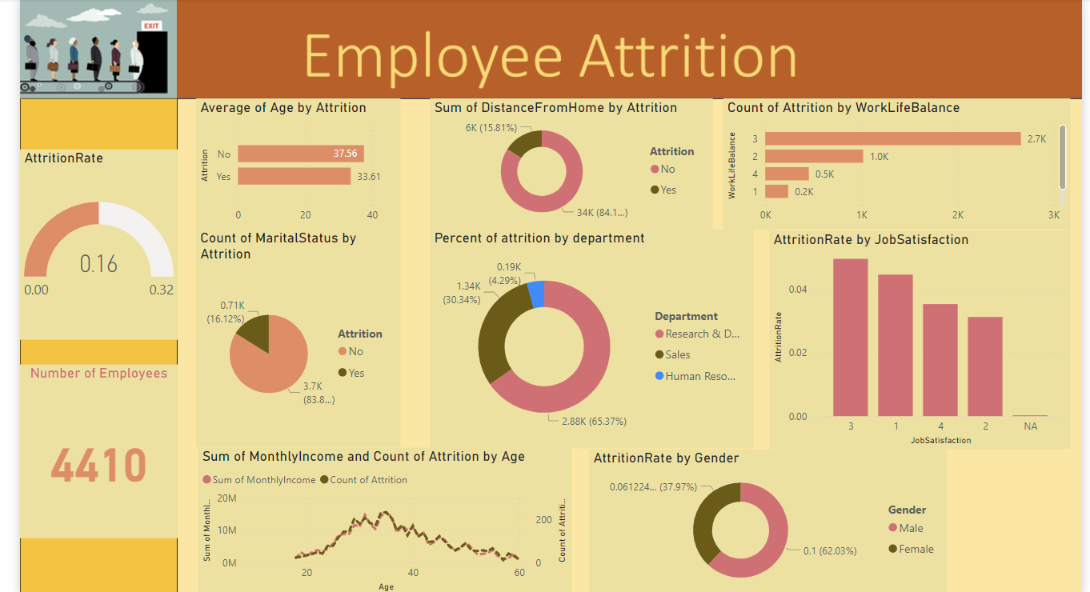
Employee Attrition

Slide 4

Employee Attrition
Key Performance Indicator:
Performance Metrics: Monitoring changes in individual or team performance before and after turnover can indicate the impact of attrition on productivity and organizational goals.
Distance from Home: The impact of commute distance on job satisfaction and performance can inform decisions related to remote work policies or office location strategies.
Monthly Salary: Analyzing salary distribution and its relationship with factors like job satisfaction and performance can highlight any disparities or areas for adjustment in compensation practices.

Slide 5

Employee Attrition
The attrition rate is highest among the males.
The distance from home could be the reason for
Attrition as the maximum distance 28km.
Research & Development department has the max
number of attrition.
Only 16% of the employees are married and left the organization.

Slide 6
Employee Attrition
Thank you!

